Slide 1

daw::string_view
Making string processing explicit and safer
Github Repo
Darrell Wright
@beached_whale

Slide 2

Danger Will Robinson
std::string_view has several areas that can easily lead to UB and security issues.
remove_prefix/suffix require that the parameter be <= size( ). This forces code to clip the value and makes find/remove_prefix code more verbose and more likely to result in UB
Char const * constructor needs pre checking for nullptr at runtime. This makes using null returning API’s more likely to result in UB

Slide 3

Safer by default
Most routines will clip to bounds, can opt into less safe versions
Nullptr is defined as an empty range, not UB
Less code. Code around find/substr/remove_prefix is a source of off by one errors

Slide 4

A few good routines
Adding find_if as a member to provide balance in the force
Hot take: nullptr forms the range [nullptr, nullptr + 0)
constructor forms an empty string_view when passed null
remove_prefix( ) removes 1.
Combining find/find_if and remove_prefix/substr leads to super powers
string_view string_view::pop_front_until(…) is the basis of a cleaner parsing. This includes the back variant too.
Argument types include char/string_view/unary predicates
Returns the skipped over part, and by default discards the delimiter.
try_pop_front_until is similar but returns an empty string_view and leaves the object alone if not found
pop_front_while similarly returns the substring formed while condition is true
These routines lead to much less complex code

Slide 5

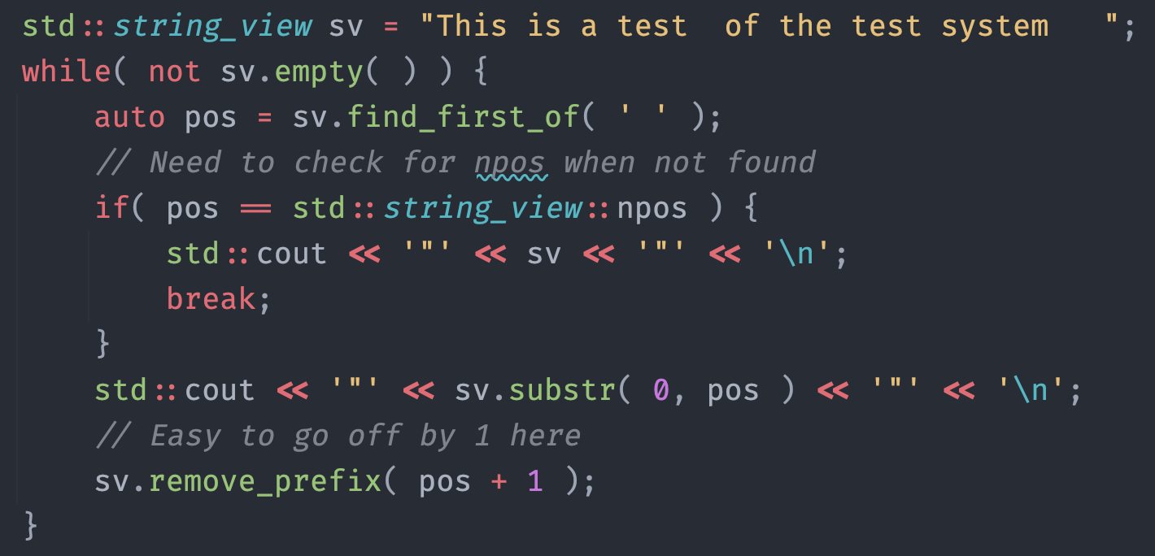
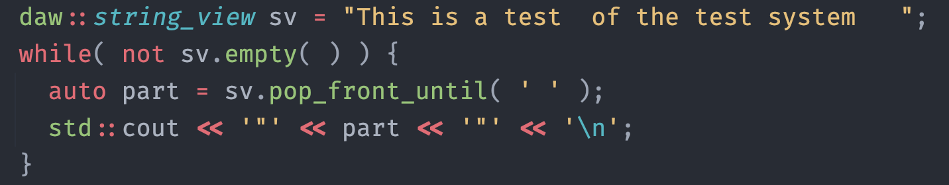
Split shouldn’t be like the Kumite
npos and remove_prefix/substr do not mix. When they do, that’s a UB
Easy off by one errors

Slide 6

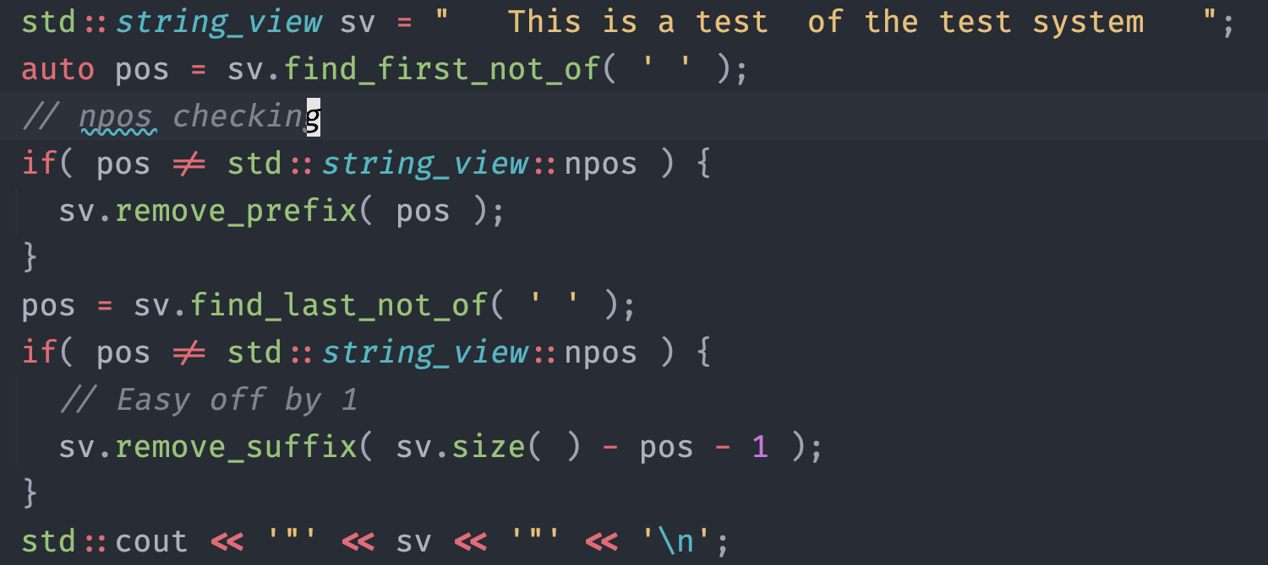
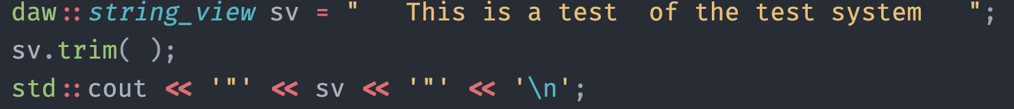
Shouldn’t need Kelly Clarkson to trim strings
Trimming of strings is painful

Slide 7

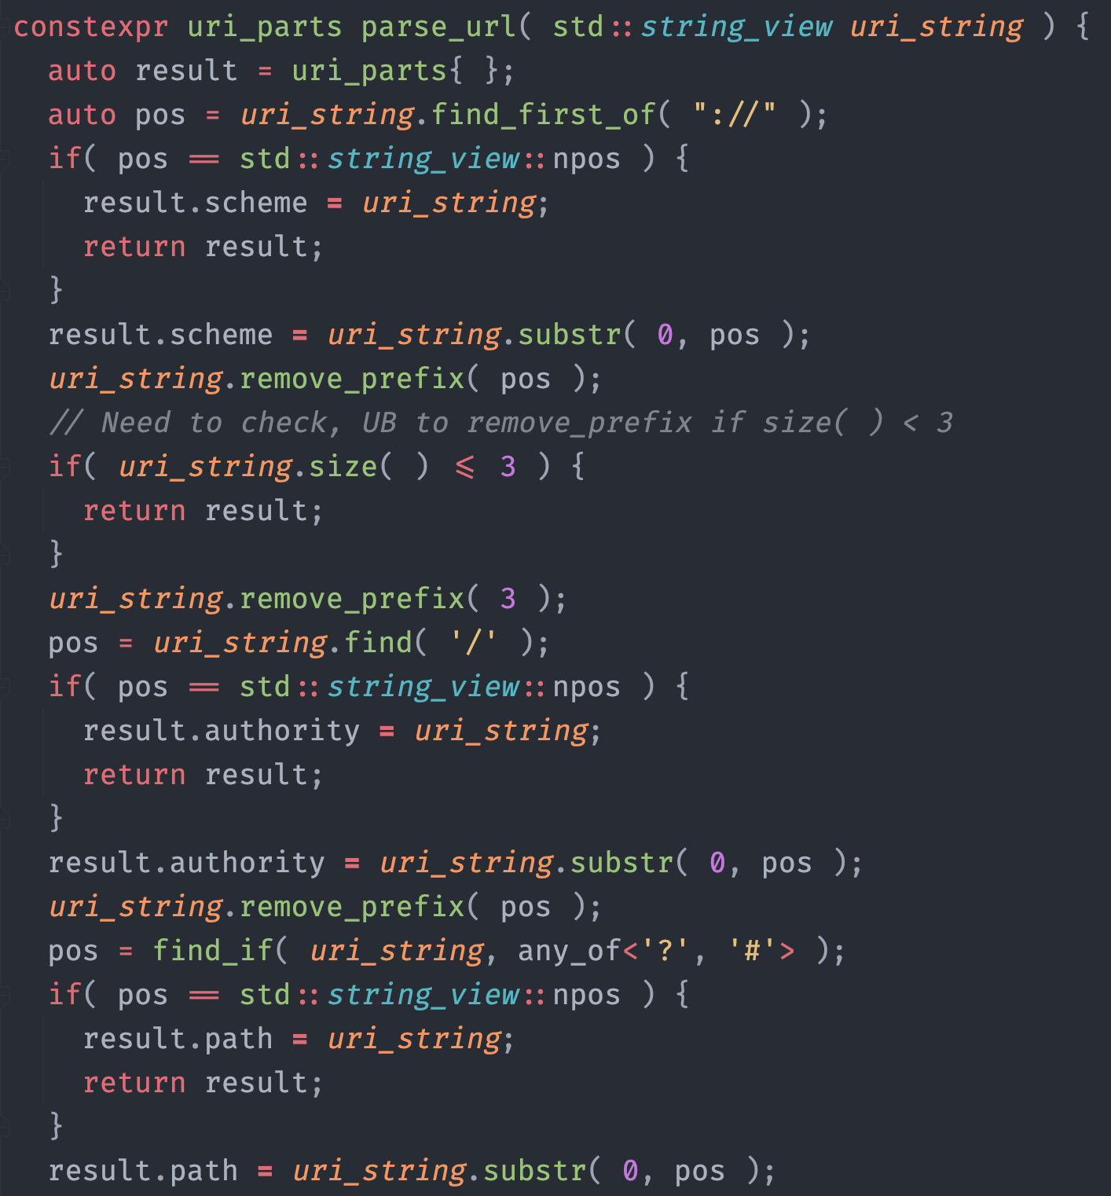
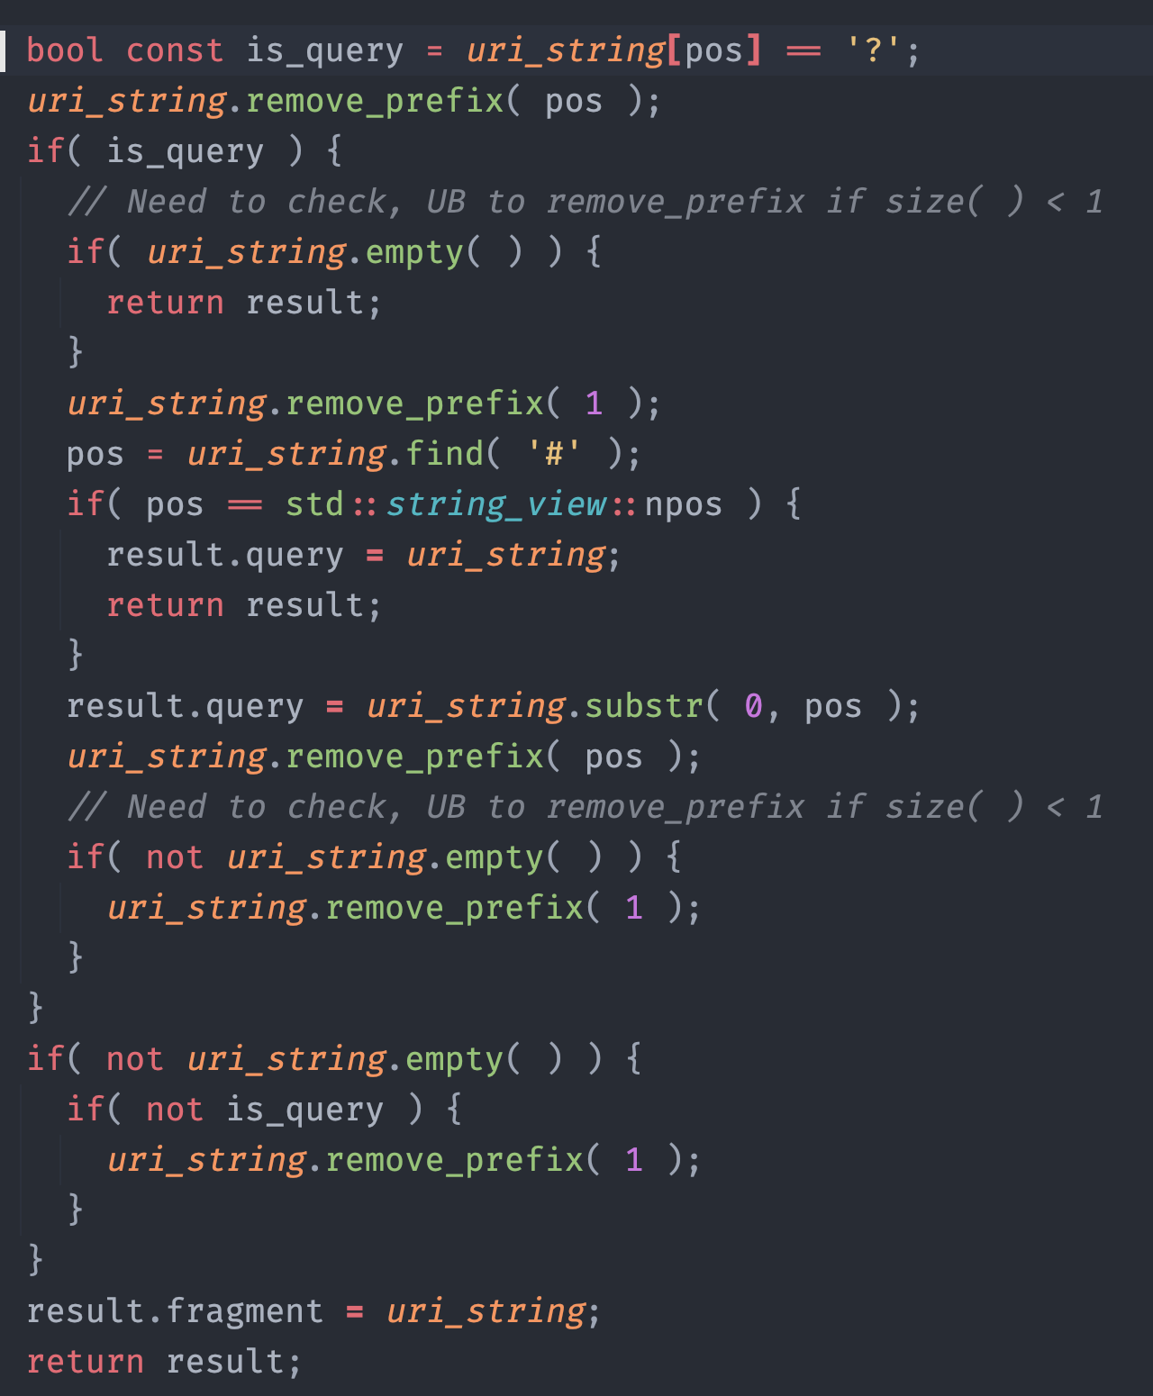
The devil is in the details of parsing
Lots of room for error/UB. Made a lot while doing examples
The code deals with indices/sizes in a lot of places

Slide 8

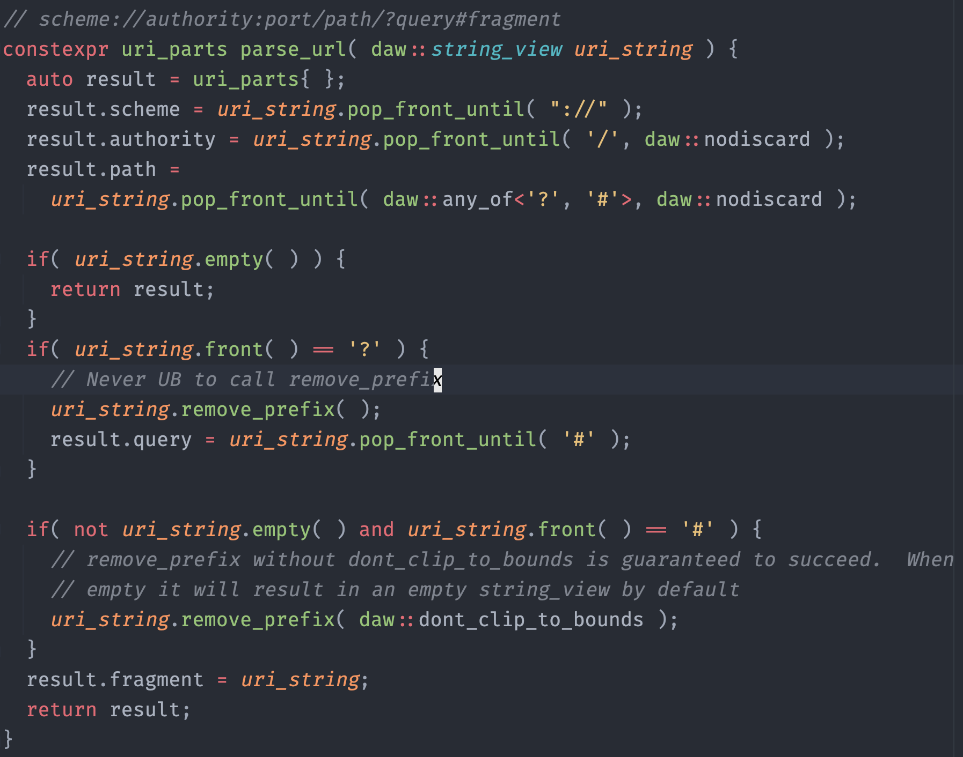
With daw::string_view it’s cleaner
Focus on the tokens/operations
Less/no indices to deal with

Slide 9

We’re Finished
Questions?

